Slide 1
Nashville Airbnb Market Analysis

Slide 2
Welcome!
Aggie Investments is exploring opportunities in the booming Nashville Airbnb market.
Key Issue: Aggie Investments is considering entering the Nashville Airbnb market but needs guidance on property acquisitions for maximum profitability.
Goal: Identify specific property characteristics and market segments with the highest potential for generating strong returns.
Data Sources: We analyzed a comprehensive dataset of current Airbnb listings in Nashville, including details on property features, host information, pricing, and guest reviews.
Key Attributes: The dataset comprises a variety of attributes, such as property size, location, amenities, host experience, pricing, and guest ratings, which were used to inform our analysis.

Slide 3
Methods
Data Preparation
We performed data cleansing to ensure data quality and consistency.
Missing values were addressed using appropriate imputation techniques to minimize bias.
Modeling Techniques
We applied a multi-faceted approach to uncover insights
Correlation analysis: Used to quantify the relationships between property features and price.
T-tests: Applied to compare average prices between different property groups.
Association rule mining: Employed to discover patterns and associations between property characteristics and positive reviews.
K-means clustering: Utilized to segment properties into distinct groups based on their characteristics.
Assumptions and Limitations
The analysis is based on current market conditions and may not fully account for future changes.
Data limitations and potential biases in the dataset could influence results.
Generalizability of findings may be limited to the Nashville market.

Slide 4
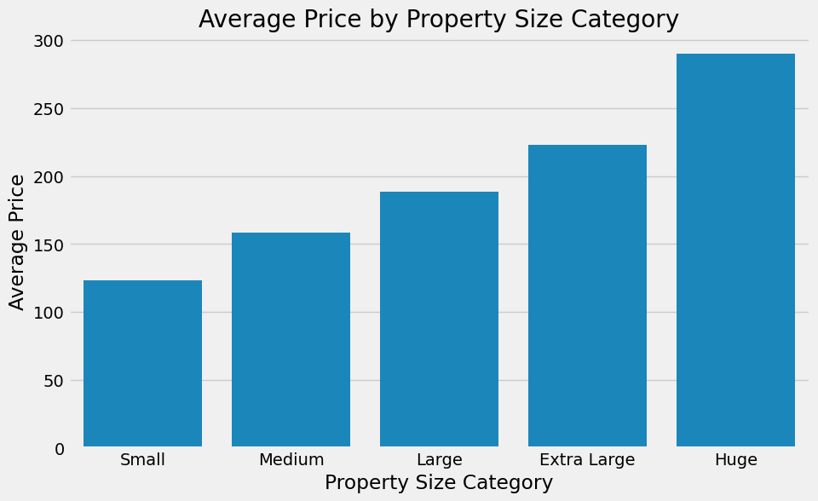
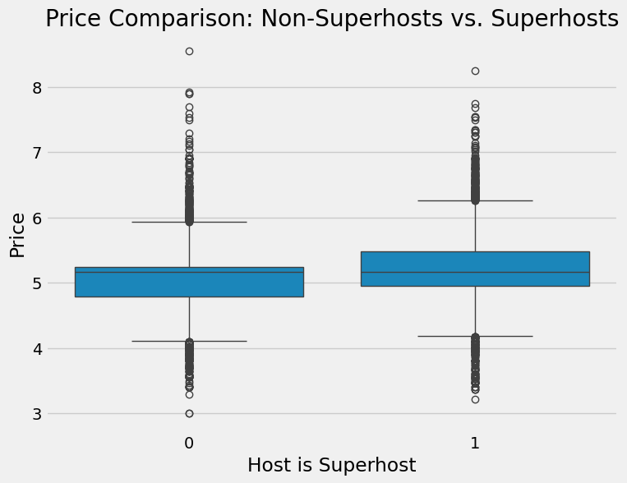
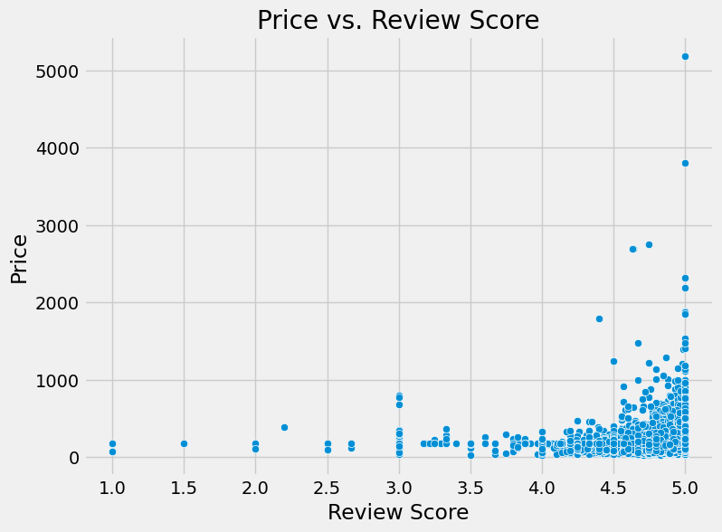
Results
Price Drivers
Attribute: Accommodates, Bathrooms, Beds
Values: Positive correlation with price, indicating larger properties command higher prices.
Explanation: Aggie Investments should consider larger properties for higher revenue potential.
Superhost Advantage
Attribute: Superhost status
Values: Superhosts have higher average prices than non-superhosts.
Explanation: Achieving superhost status can lead to a price premium and increased bookings.
Review Scores
Attribute: Review scores (overall rating, location, value)
Values: High review scores are strongly associated with higher prices and booking frequency.
Explanation: Maintaining excellent review scores is crucial for attracting guests and maximizing revenue.

Slide 5
Interpretation
Clustering Analysis:
Our K-means clustering analysis identified 6 distinct property segments in the Nashville Airbnb market.
This segmentation allows Aggie Investments to understand the different types of properties available and target specific clusters that align with their investment goals.
Cluster Characteristics
We labeled these clusters based on their key features, such as "Budget-Friendly/Lower-Rated," "Economic Private Residence," "High-End/Luxury," "Hotel-like Rooms/Business Travel," "Superhost Shared Spaces/Value-Oriented Superhosts," and "Long-Term Budget Stays/Extended Stay Value.“
Each cluster represents a unique combination of property attributes, price points, and guest preferences.
Budget-Friendly/Lower-Rated : High-Risk, Low-Return
Brief Explanation: Budget-focused, lower prices, fewer amenities, potentially lower occupancy and revenue.
Economic Private Residence : Moderate-Risk, Moderate-Return
Brief Explanation: Private rooms, budget-friendly, stable demand, limited revenue growth potential.
High-End/Luxury : Low-Risk, High-Return
Brief Explanation: Higher prices, more amenities, superhost status, potential for high occupancy and revenue.
Hotel-like Rooms/Business Travel : Niche Market, Moderate Return
Brief Explanation: Hotel-focused, consistent demand, but lower review scores might limit pricing power.
Superhost Shared Spaces/Value-Oriented Superhosts : High-Occupancy Potential, Moderate-Return
Brief Explanation: Superhosts with shared spaces, value-oriented, potential for high occupancy but moderate returns.
Long-Term Budget Stays/Extended Stay Value : Stable Income, Moderate-Return
Brief Explanation: Long-term stays, lower prices, stable income stream, but limited revenue growth potential.

Slide 6
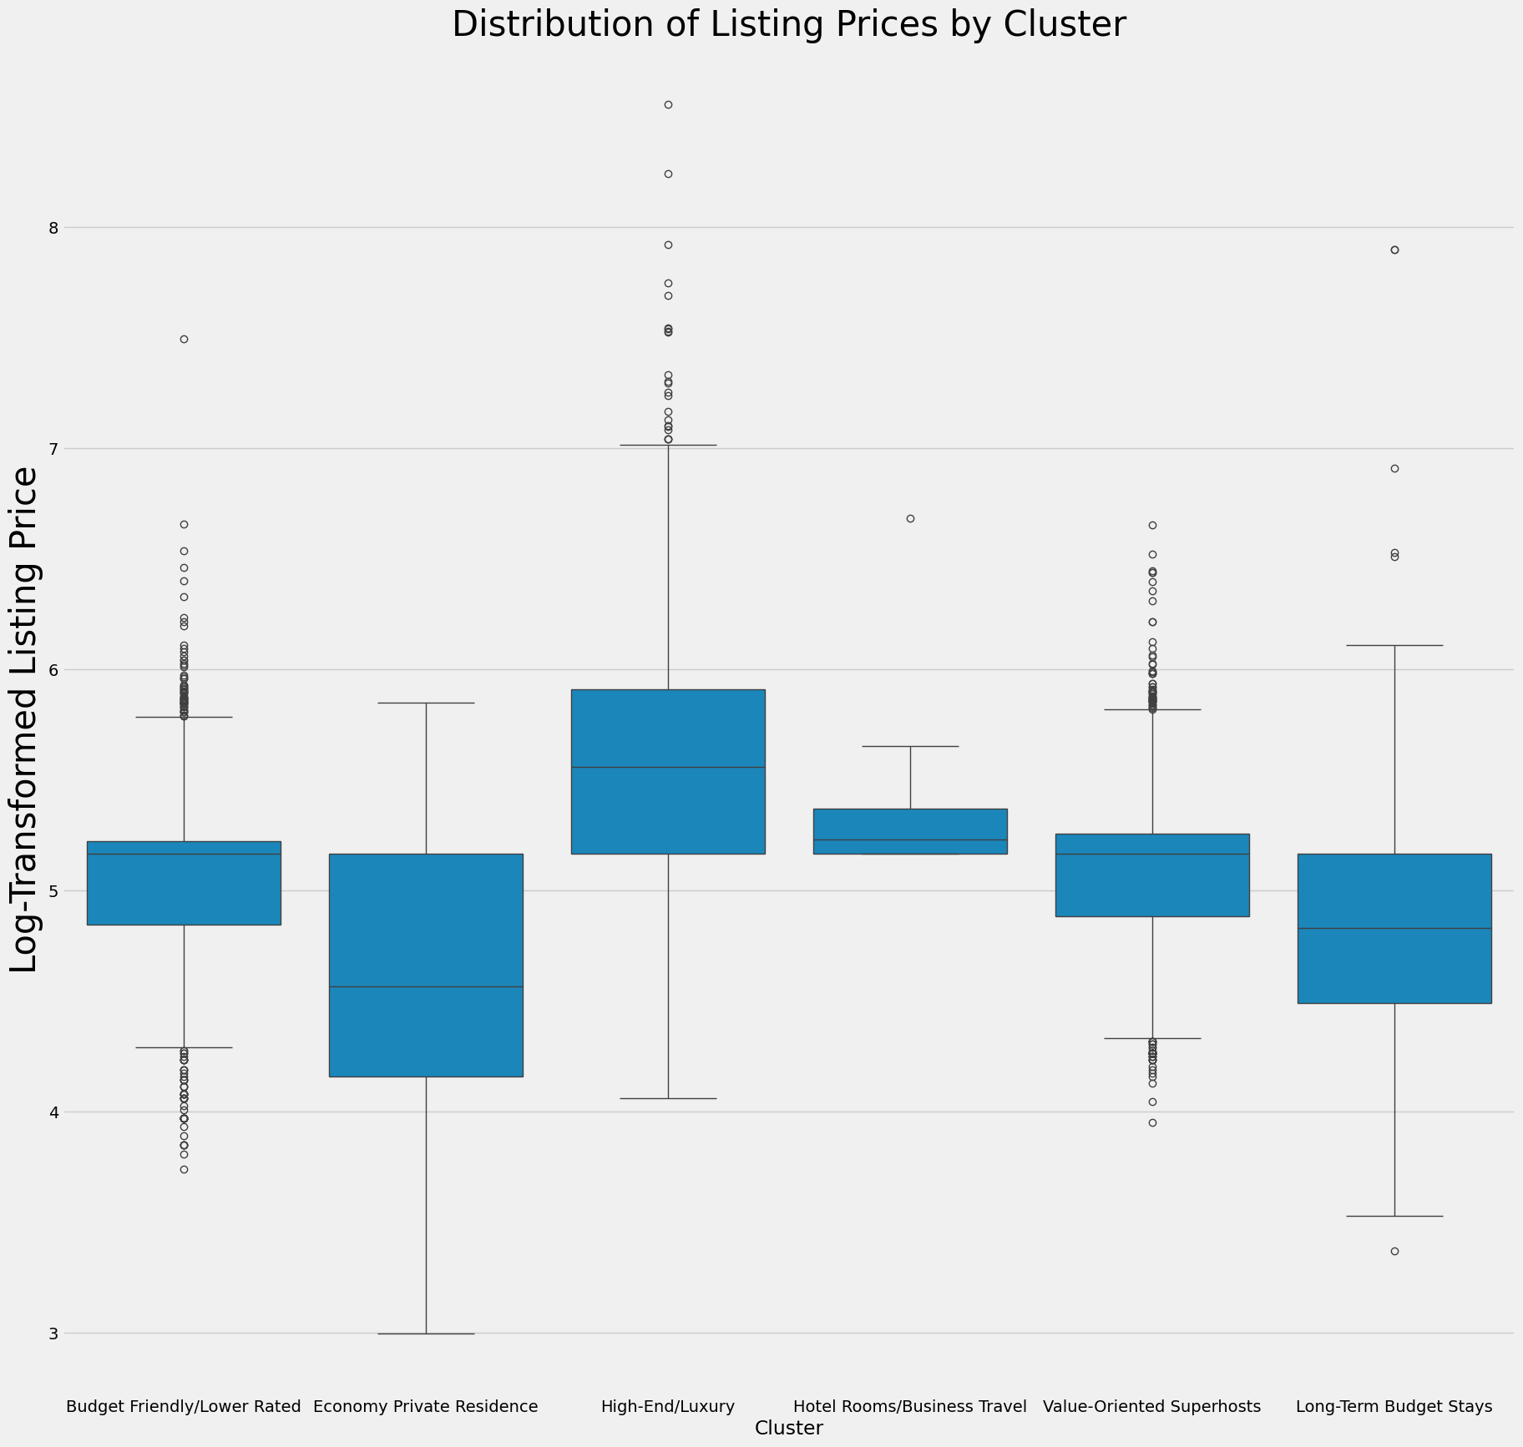
Business Recommendations
Recommendations
Aggie Investments should prioritize acquiring properties that align with the Luxury/High-End Cluster and the Value-Oriented Superhosts.
Low-Risk, High-Return (Luxury/High-End): These properties offer higher prices, more accommodations, and are more likely to be superhosts, maximizing revenue potential and minimizing risk.
High-Occupancy Potential, Moderate-Return (Superhost Shared Spaces): These properties, often managed by superhosts, cater to budget-conscious travelers seeking shared spaces, offering the potential for consistent occupancy and moderate returns.
Management Strategies
Superhost Program: Actively pursue superhost status for all properties, as it significantly impacts pricing and demand.
Pricing Optimization: Implement dynamic pricing strategies to maximize revenue based on seasonality, demand, and competitor pricing.
Guest Experience: Prioritize exceptional guest experiences through personalized communication, amenities, and local recommendations.
Property Maintenance: Maintain properties to high standards to ensure positive reviews and repeat bookings.
Marketing and Branding: Develop a strong online presence and brand identity to attract target audiences and differentiate Aggie Investments' properties.
Long-Term Rentals (Consideration): Explore opportunities in the Stable Income, Moderate-Return (Cluster 5) segment for long-term rentals to provide a consistent income stream alongside short-term rentals. This can offer portfolio stability during fluctuations in the short-term rental market.

